Slide 1
Sixth Form Open Evening

Slide 2
Options Process
Students will be asked to read the booklet very carefully and consider all of the information.
Make sure you do as much research as you can around the subjects you are interested in studying. You can look at the exam board website to find out the full specifications of each subject.
You will need to speak to your teachers to discuss your progress and whether the course is right for you. If you are coming from another school or you do not know who best to contact just get in touch and we will be able to give you the correct email address.
If we can, we will run an Open Evening in the summer term to allow you to visit the sixth form and meet the staff.

Slide 3
Options Key Dates
3rd February : Penglais Parents’ Evening
14th February: Return of options sheet

Slide 4
How do I return the option selection?
Once you have made your decisions please highlight your chosen subjects return the sheet to your form tutor. If you are joining from another school please send to snt@penglais.org.uk
We need to have your return by the date specified to allow us to plan accordingly.
You may need to think about a reserve option or combination of options as we cannot guarantee all courses will run. This could be because of numbers of students opting for a subject or could be because of funding constraints.
If you have a clash you need to explain in the email why you would like to study this combination of subjects and we will look at the clash. We have in some situations moved subjects but this will depend on the number of students involved and staffing requirements.
If you are unsure of anything please do not hesitate to contact me on hgg@penglais.org.uk

Slide 5
U | V | W | X | Y | Z
Chemistry Music Health and Social Care Mandarin PE WBQ | Biology History Media Studies French Product Design Psychology WBQ | Physics Geography English Literature Welsh Second Language Business WBQ | Maths Drama Spanish Tourism Geography Biology WBQ | Art Further Maths Sociology IT BTEC L3 History WBQ | Eng / Ma Resit
The majority of students will choose and study 3 subjects plus the WBQ

Slide 6
Do consider | Don’t base your decision on
What you are good at | What your friends choose
What you enjoy | Who may or may not teach you
How you work best | A ‘hunch’ – for some subjects it is a big step up from GCSE to A Level
What motivates you | What your parents would like you to study
What you would be studying for 2 years
University and course entry requirements
Career opportunities opened up

Slide 7
Introduction / Cyflwyniad
Large Sixth Form approximately 260 students
Cosmopolitan, lively, dynamic
Successful – excellent outcomes
Dedicated team of experienced experts
Purpose built, modern facilities
Chweched Dosbarth – 260 o ddisgyblion
Cymysg, bywiog, deinamig
Llwyddiannus – canlyniadau ardderchog
Tîm ymrwymiedig o arbenigwyr profiadol
Cyfleusterau modern, canolfan arbennig

Slide 8
The Team / Y Tîm
Head of Sixth Form | Mrs J Elgood | jje@penglais.org.uk
Sixth Form Manager | Miss S Thomas | snt@penglais.org.uk
Lead Learning Coach | Miss E Homer | e.homer@penglais.org.uk
Learning Coach Learning Coach | Dr M Lewis Mr K Holland | dml@penglais.org.uk k.holland@penglais.org.uk
Learning Coach | Miss Helen Yates | h.yates@penglais.org.uk
Attendance & Support Worker | Miss E Asukile | e.asukile@penglais.org.uk
Ysgol Penglais School | 01970 624 811
Sixth Form Centre | 01970 621 163
Email | admin@penglais.org.uk
Twitter | @PenglaisSchool
Facebook | Ysgol Penglais School
Website | www.penglais.org.uk
Alumni | alumni@penglais.org.uk

Slide 9
What is different about being in Sixth Form?
Students register themselves into and out of school
Students can leave the school site if they have a non-contact lesson
Students have an appointed learning coach and specialist UCAS/university application tutor
Students do not have a full timetable of lessons
During tutor time, break and lunch the Sixth form team are available in the Sixth Form Centre
The Sixth form have their own building which is open from 8am to 5pm most days

Slide 10
What is different about being in Sixth Form?
Students can use their mobile phones in the Sixth Form Building
Coffee machine
The Sixth Form car park is on Cefn Llan
Information and opportunities are sent by email to students and parents (via parent mail)
Sixth form students are role models and are involved in the life of the school through leadership and enrichment activities
Unifrog – careers and destination platform
VESPA system is used to support the transition from GCSEs to A levels

Slide 11
However some things remain the same!
Uniform
Excellent attendance to lessons, work and behaviour
Attendance – students notify teachers, parents notify Miss Asukile
Assembly – VESPA, Current affairs
PSHE

Slide 12
Entry into Sixth Form
5 GCSEs grades A*- C (or GCSE equivalent e.g.BTEC) preferably including English and Maths
Some subjects have B or A grade entry requirements (see Option Book) and a need for a particular tier of entry
Results Day is in August. Staff will be present and available to advise students if this requirement is missed or to book an appointment for one of the enrolment days
Enrolment Days. An appointment with one of the SFT or SLT to discuss the selection of options and to complete all paperwork. These days will be held during the last week of August.

Slide 13
Studying/Astudio
3 - 4 subjects and the WBQ are selected in year 12
5 lessons per cycle (100mins) in year 12, 5 in year 13
Hard work, commitment, drive, independent learners beyond the curriculum
Collaboration and a positive attitude
3 - 4 pwnc a’r Bagaloriaeth Cymraeg ym mlwyddyn 12
5 gwers blwyddyn 12, 5 blwyddyn 13
Gwaith caled, ymrwymiad, dysgwyr annibynol tu hwnt i’r cwricwlwm
Cydweithio ag agwedd positif

Slide 14
Currently on roll
Year 13 : 126
Year 12: 133

Slide 15
Success/ Llwyddiant
88% grades A*- C
52 % 3 x A*- A
Oxbridge - 2022 8 students achieved an interview. 3 confirmed places for Oxbridge so far this year
70% at prestigious universities
Places achieved for competitive subjects – Engineering, Medicine, Veterinary science, Dentists, Law, physiotherapy, midwifery
80% of students in year 13 have applied to university, others applying for 2023 entry
Foundation year degrees
Apprenticeships, gap years, study abroad
Destinations far and wide in the UK and abroad.

Slide 16
A level Provision/Darpariaeth Lefel A
Subject Specialists teach A level subjects
All lessons are on site
Broad range of subjects on offer
Excellent facilities
Strong links with Aberystwyth University
Links with parents and the local community
Arbenigwyr pwnc sy’n dysgu pynciau lefel A
Dysgir pob gwers ar safle’r ysgol
Ystod eang o bynciau ar gael
Cyfleusterau gwych
Prifysgol ar ein trothwy
Cyswllt gyda rhieni a’r gymuned leol

Slide 17
Enrichment and Leadership programmes/ Rhaglen Cyfoethogi ac Arweinyddiaeth
Debate Group
Model UN Conference
Lectures at the university
Visits to universities
Community Participation
Work experience
BBC digital literacy
Auschwitz programme
Seren opportunities
Law competition
Grŵp Trafod
Ffug- Gynhadledd y Cenhedloedd Unedig
Darlithoedd yn y Brifysgol
Ymweliadau i brifysgolion
Cyfranogiad Cymunedol
Profiad Gwaith
BBC Digidol
Rhaglen Auschwitz
Seren
Cystadleuaeth y gyfraith

Slide 18
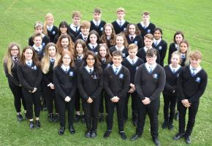
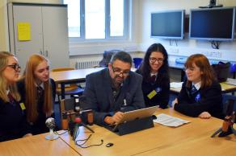
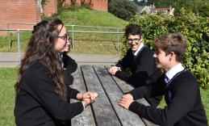
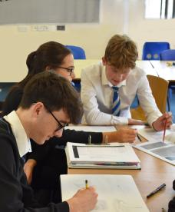
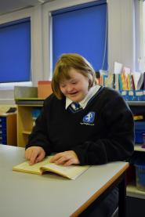
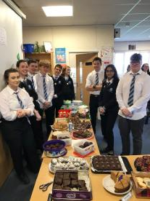
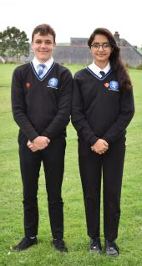

Slide 19
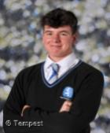
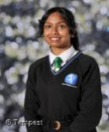
Head Boy and Head Girl 2021 to 2022

Slide 20
What you need to consider
What do these subjects involve?
Read the guide in the options booklet, speak to subject teachers, look at the specification for these subjects. These are available on the exam board websites e.g. wjec.co.uk
Find out about:
the topics covered – some of the subjects are new to pupils in Year 12
what work is involved e.g. essays, practicals, fieldwork ?
how is the subject examined – is there a lot of coursework, is it all based on exams?
can you opt for the subject if you have not studied it at GCSE Level? Languages will have to have been studied at GCSE to be able to opt at A Level.
Can you opt for some subjects if you have studied it at Foundation Tier in GCSE to be able to access it at A Level?
The pass grade range at A level is A-E, and an achievement
Cambridge Technicals are well suited to students who prefer a balance of exams and course. Distinction*= grade A* at A level (56 UCAS points)

Slide 21
You also need to be looking 2 years ahead
If you have a good idea of what course you might like to study at University or College then you need to be looking at the entry requirements for these courses. How many A Levels do they require, what combination do they require?
If you have a good idea of where you might like to study at University then you need to be looking very carefully at entry requirements for these courses – do they accept all A Levels, or not?
This is particularly important if you are looking at the Universities with the highest entry requirements – you don’t want to choose your options and aim to go to a particular institution only to find they don’t accept some of your subject choices.
You can find information on this from Unifrog, University websites, as well the staff in the Sixth Form Centre and the Careers Advisor (Ms Yvonne Owen-Newns) Yvonneowen-newns@careerswales.gov.wales

Slide 22
Facilitating subjects – these are commonly asked for in a university’s entry requirements
Physics
Biology
Chemistry
English Literature
Geography
History
Maths
Modern Foreign Language

Slide 23
Subject combinations
Certain subjects complement each other
Sciences – Biology, Chemistry, Maths or Physics
Social sciences – Psychology, Sociology, Geography/English/History
Languages – Spanish, French, English
Creative – Music, Drama, Media
But this does depend on what you would like to study in university. Use these sites to help your search
https://www.theuniguide.co.uk/a-level-explorer
https://www.informedchoices.ac.uk/
Unifrog

Slide 24
Careers and certain subjects at university have specific subject requirements
Medicine, Veterinary, Dentistry – Chemistry, Biology
Architecture – Product Design/Art, Maths/Physics
Law – History/English
Natural Sciences - Maths
Design – Product Design/Art
Engineering – Maths, Physics, Further Maths
Economics – Maths
Journalism – English
Health care/Nursing/Physiotherapy – science or science based subject (Geography, Psychology, PE)

Slide 25
Apprenticeships – level 4 (equivalent to a foundation degree or the first year of a degree)level 5 (equivalent to a full degree)
https://www.ucas.com/apprenticeships-uk
https://gov.wales/welsh-government-apprentices
Unifrog
Students in Penglais have been successful in following level 4 and 5 apprenticeship with
Dyson
Landrover
Welsh Government
Accountancy

Slide 26
Jobs
Preparing you for full or part time work.
Developing your CV and support with letters of application.
Writing your reference.

Slide 27
Questions
Please add questions in the
Q & A facility.

